Slide 1
DBMS
REVIEW-2
Project Name :- Crop planning & farm input management system
Name:- Mohammed Ayman
Roll number :- 25WU0102162

Slide 2
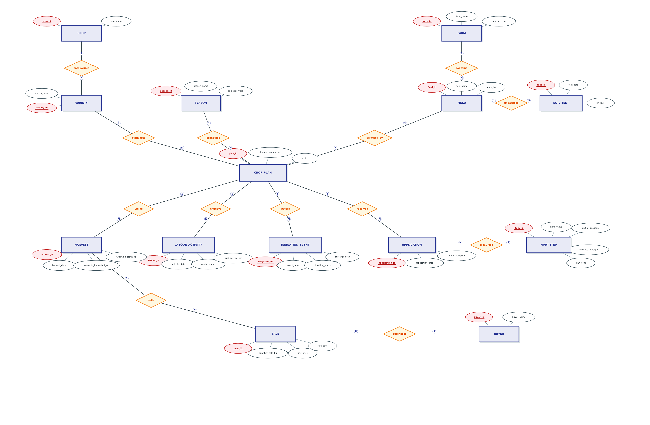

Slide 3
